Slide 1
STEGNOGRAPHY
CAPSTONE PROJECT
Presented By: Harshit Kumar Pathak
Student Name : Harshit Kumar Pathak
College Name & Department : Parul Institute of Engineering and Technology & CSE(Cybersecurity)

Slide 2
OUTLINE
Problem Statement
Technology used
Wow factor
End users
Result
Conclusion
Git-hub Link
Future scope

Slide 3
Problem Statement
As digital communication continues to expand, protecting sensitive information becomes more and more essential. Traditional encryption can attract attention, making steganography a discreet alternative. This project hides secret messages in images by changing the value of the pixels in the blue channel using OpenCV. The message can only be decrypted and retrieved by authorized users through a password that ensures secure and covert data transmission.

Slide 4
Technology used
Programming Language : Python
Image Processing Library: CV2
File Handling & Security: Basic encryption logic for password protection
Platform: Windows 11
IDE: VS Code
Deployed : Github

Slide 5
Wow factors
Minimal Image Distortion - Only the blue channel is altered to preserve quality of the intelligence analysis.
Passcode Locked - Messages can be decrypted only by the person who knows the passcode.
Accurate Recovery - The message length is recorded in the first pixel for correct, accurate decoding.
Fast and Efficient - Done with OpenCV and NumPy.
Scalable - Possible to upgrade with LSB steganography or AES encryption.

Slide 6
End users
🔹 Cybersecurity Enthusiasts – Individuals exploring steganography and data hiding techniques. 🔹 Journalists & Activists – Those needing covert communication in restrictive environments. 🔹 Developers & Researchers – People working on image processing, security, or cryptography. 🔹 Privacy-Conscious Users – Individuals wanting to hide sensitive data in images securely. 🔹 Educational Purposes – Useful for learning steganography, OpenCV, and encryption concepts.

Slide 7
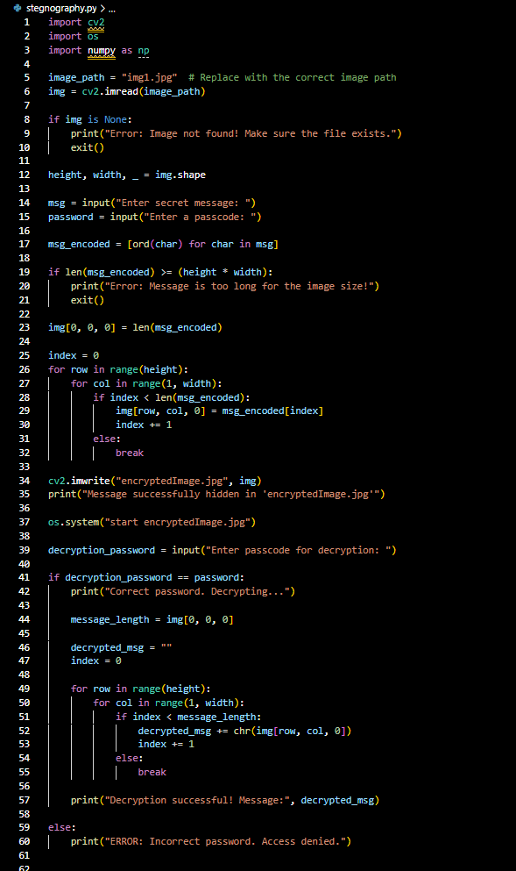
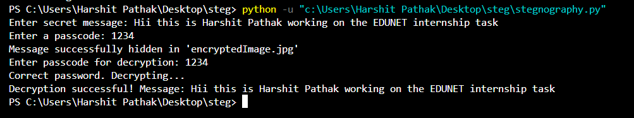
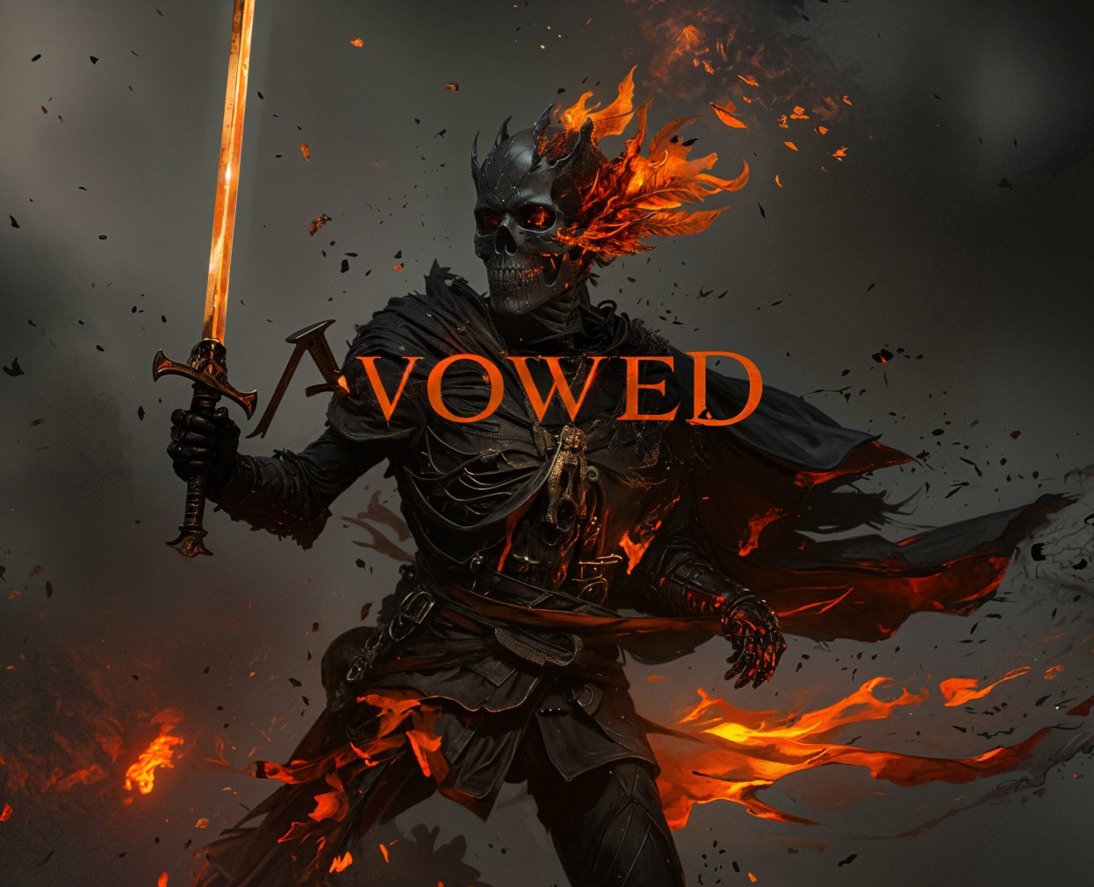

Results
Code
Execution
Input Image: Output Image:
Img1.jpg
encryptedimage.jpg

Slide 8
Conclusion
This project showcases an easy yet efficient method of image-based steganography that enables users to conceal and extract secret messages securely. By altering the blue channel only, it preserves minimal image distortion while ensuring rapid and efficient processing via OpenCV and NumPy. The inclusion of passcode protection further boosts security, excluding unauthorized access. With possible improvements such as LSB-based steganography or AES encryption, this project is a good basis for safe covert communication and future research into digital steganography.

Slide 9
GitHub Link
https://github.com/peror404/Stegnography

Slide 10
Future scope
🔹 LSB-Based Steganography – Implement Least Significant Bit (LSB) encoding to further reduce image distortion and enhance security.
🔹 AES Encryption Integration – Encrypt the message before embedding it into the image for an extra layer of security.
🔹 Support for Different File Formats – Extend compatibility to hide messages in formats like PNG, BMP, and GIF for better quality retention.
🔹 GUI Implementation – Develop a user-friendly graphical interface using Tkinter or PyQt for easy encryption and decryption.
🔹 Steganalysis Detection Resistance – Improve the algorithm to make detection harder for forensic analysis tools.
🔹 Mobile & Web Application – Expand the project into a mobile app or web-based tool for broader accessibility.

Slide 11
THANK YOU

